Slide 1
Exploring and evaluating best practice in teaching research methods
Peter Hills
Bournemouth University
Notes:
1

Slide 2
Background
Research methods are widely regarded as ‘difficult’ subjects to teach (e.g., Conners et al., 1998)
Student attitudes toward these topics are often negative (Murtonen, 2005; Sizemore and Lewandowski, 2009)
Student engagement in them is low (Vittengl et al., 2004; Rottinghaus et al., 2006).
Notes:
Conners, F. A., McCown, S. M., & Roskos-Ewoldson, B. (1998). Unique challenges in teaching undergraduates statistics. Teaching of Psychology, 25(1), 40-42.
Murtonen, M. (2005). University students' research orientations: Do negative attitudes exist toward quantitative methods?. Scandinavian Journal of educational research, 49(3), 263-280.
Sizemore, O. J., & Lewandowski Jr, G. W. (2009). Learning might not equal liking: Research methods course changes knowledge but not attitudes. Teaching of Psychology, 36(2), 90-95.
Vittengl, J. R., Bosley, C. Y., Brescia, S. A., Eckardt, E. A., Neidig, J. M., Shelver, K. S., & Sapenoff, L. A. (2004). Why are some undergraduates more (and others less) interested in psychological research?. Teaching of Psychology, 31(2), 91-97.
Rottinghaus, P. J., Gaffey, A. R., Borgen, F. H., & Ralston, C. A. (2006). Diverse Pathways of Psychology Majors: Vocational Interests, Self‐Efficacy, and Intentions. The Career Development Quarterly, 55(1), 85-93.

Slide 3
Previous Research
Freeman et al. (2014): traditional methods of teaching statistics was shown to be less effective (exam performance and satisfaction), compared to other subjects of study
Elliott et al., (2010): active tuition leads to higher levels of enjoyment but not higher exam performance
Neumann et al., (2010, 2013) class-generated data lead to better outcomes
Notes:
Freeman, S., Eddy, S. L., McDonough, M., Smith, M. K., Okoroafor, N., Jordt, H., & Wenderoth, M. P. (2014). Active learning increases student performance in science, engineering, and mathematics. Proceedings of the National Academy of Sciences, 111(23), 8410-8415.
Elliott, L. J., Rice, S., Trafimow, D., Madson, L., & Hipshur, M. F. (2010). Research participation versus classroom lecture: A comparison of student learning. Teaching of Psychology, 37(2), 129-131.
Neumann, D. L., Neumann, M. M., & Hood, M. (2010). The development and evaluation of a survey that makes use of student data to teach statistics. Journal of Statistics Education, 18(1).
Neumann, D. L., Hood, M., & Neumann, M. M. (2013). Using real-life data when teaching statistics: student perceptions of this strategy in an introductory statistics course. Statistics Education Research Journal, 12(2).

Slide 4
Lots of resources and recommendations
Guidelines for Assessment and Instruction in Statistics Education (American Statistical Association):
emphasizing statistical literacy and thinking,
making use of real data,
focusing on conceptual understanding,
promoting active learning,
making use of technology
administering assessment appropriate to evaluating learning in the classroom.
Notes:
https://www.amstat.org/asa/education/Guidelines-for-Assessment-and-Instruction-in-Statistics-Education-Reports.aspx

Slide 5
Lots of resources and recommendations
Skills in Mathematics and Statistics in Psychology and tackling transition (HEA):
diagnostic testing of their students’ knowledge,
Utilise additional support,
Adequate reviewing of performance.
Notes:
https://www.advance-he.ac.uk/knowledge-hub/skills-mathematics-and-statistics-psychology-and-tackling-transition

Slide 6
Methodology
Survey of methods across the country emailed to all HoDs:
41 Staff replied &107 Students replied
22 Universities represented (6 Russel Group)
General information (course size, type of University, course involvement)
Opinions on what work, engagement
Survey of grades achieved (only 2 HoD responses, so not analysed)
Notes:
Firstly, one point that is worth noting is that although the student sample size is reasonable, it may not be representative of the whole target student population. There is a very even mix between the new universities and Red brick (a total of 17 universities). However, some universities dominate e.g. Sussex (93 respondents), Nottingham Trent (56) and Chester (37). Just these three universities represent almost 70% of the total sample. Not surprisingly, almost all respondents were full-time students.
6

Slide 7
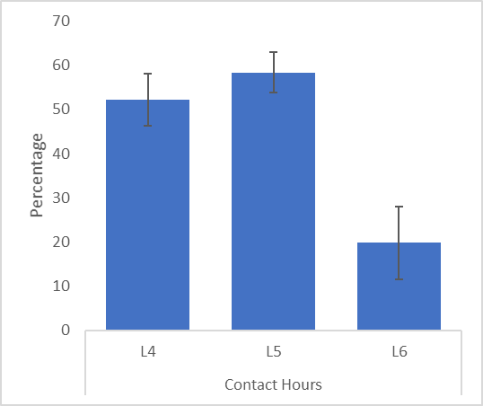
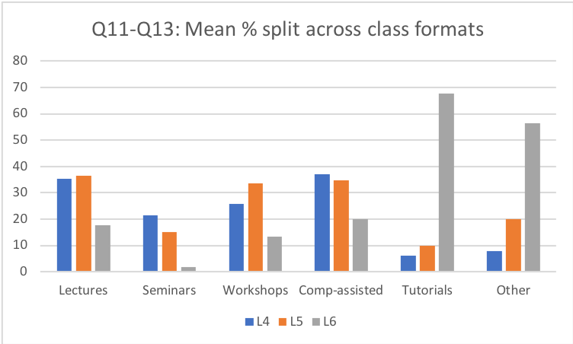
What happens
Mean mark for first report: 66%
Mean mark for L4 RM: 70%
Approximately 70% of students engage in online material (according to staff)
Approximately 5 extra sessions run in
17% of students report using something other than SPSS
26% report online resources
34% use video clips
Notes:
Extra sessions more common for stats than qual esp at level 4 (level 4 qual and RM sessions seem more focused on traditional sessions)
Video clips rated as really useful

Slide 8
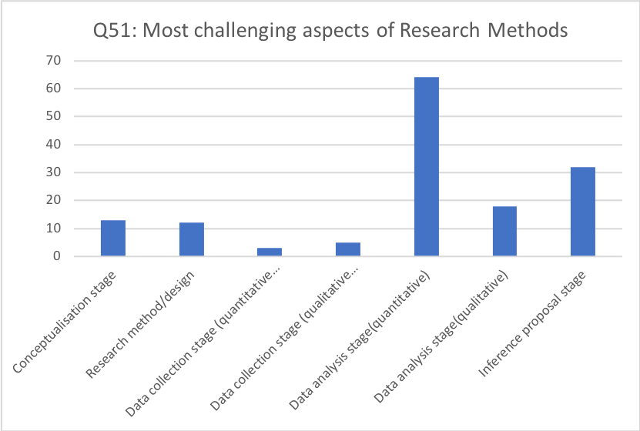
What happens
Notes:
66% of students surveyed prefer quantitative methods
The majority of students who responded had some previous experience of research methods (64%).

Slide 9
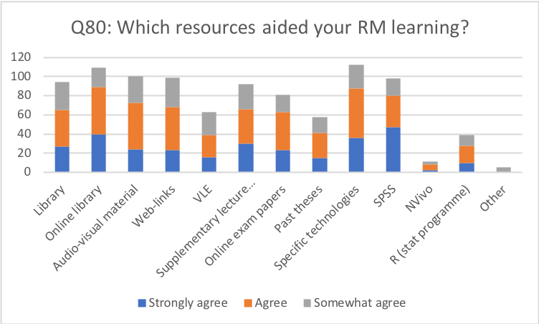
What works
Notes:
In true NSS style satisfaction

Slide 10
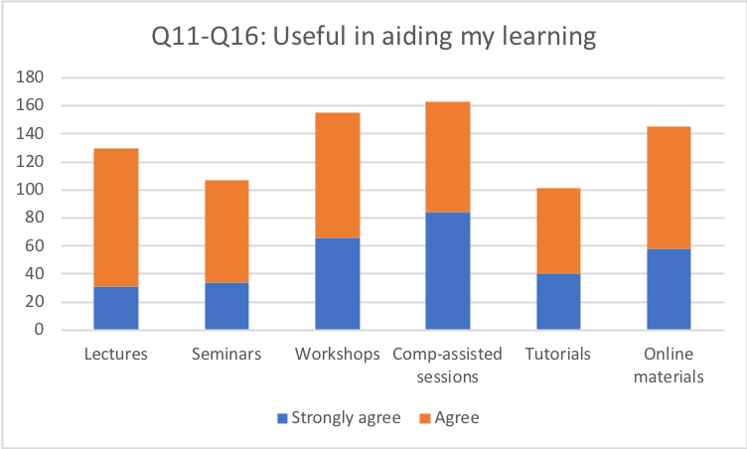
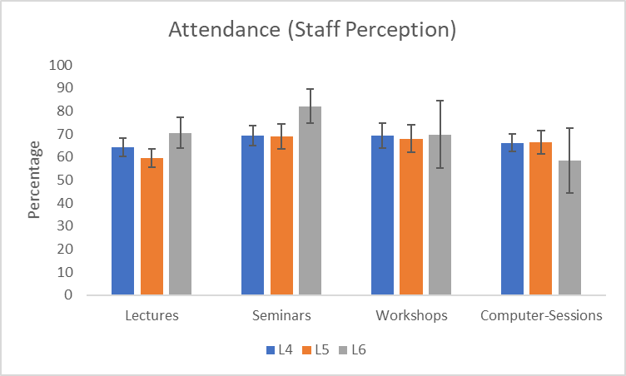
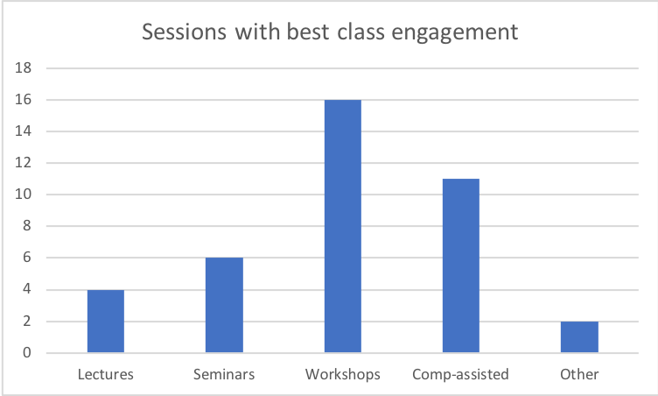
What works

Slide 11
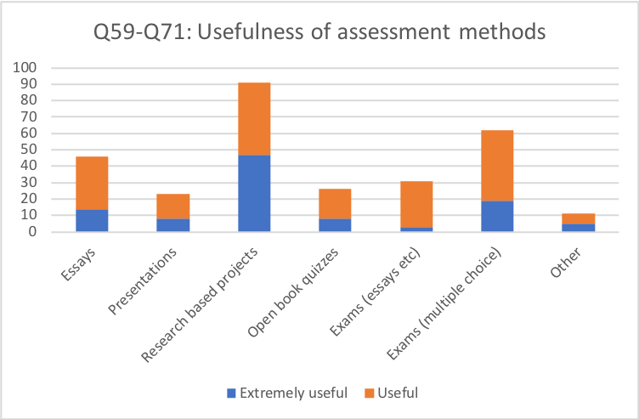
What’s assessed
Notes:
66% found feedback useful

Slide 12
What’s liked

Slide 13
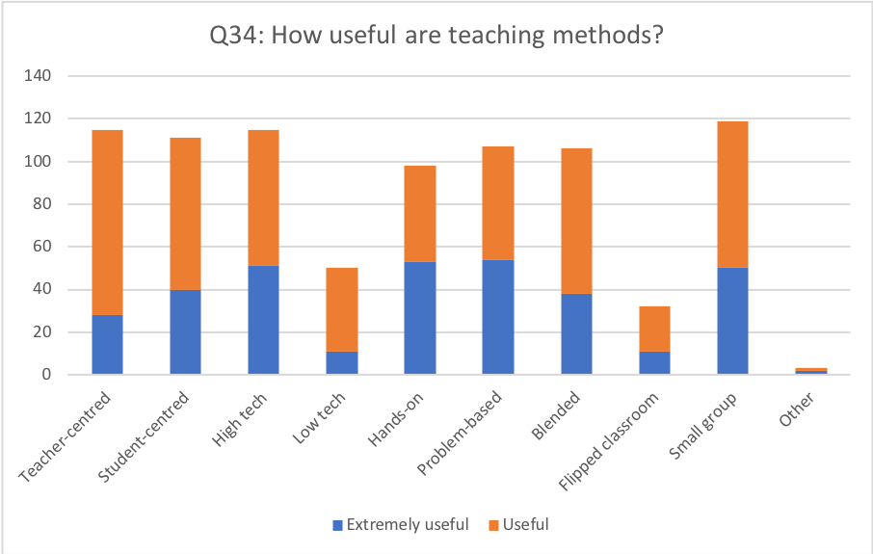
What works
Notes:
The data suggested most students felt supported by the lectur
In response to the question on how useful different teaching methods were (Q34), the ranking based on scaling all responses (see note below) indicated that high technology-based methods (1.63) were most useful, closely followed by problem-based (1.57) and then small group (1.55) sessions. The lowest scores were for flipped classroom (0.27) and low technology-based methods (0.47). Surprisingly, and in contradiction with some of the other responses, the third worst scoring method was “Hands On” (1.22).

Slide 14
Notes:
There is a clear bias in the teaching of research methods towards the use of quantitative methods. The top areas covered in research methods (Q 48) were selecting methodology and techniques (joint 1st), sampling methods (3rd), Validity (joint 5th), reliability (8th) and variability (9th) with only referencing (4th), report writing (7th), and ethics (joint 5th) appearing in the top ten topics. The bottom three places were occupied by use of NVivo (42nd), framework analysis (41st) and narrative analysis (40th). There is a close correlation between these responses and the responses from staff (rank correlation coefficient = 0.738, n=42, p<.000). The top ranked topics from the staff questionnaire (Staff Q26) were largely quantitative e.g. validity, reliability, measures of central tendency, variability, t-tests, ANOVA, use of SPSS, correlation, regression and parametric/non-parametric tests together with report writing and research methods techniques. The lowest ranked topics included the use of R (rank 42nd; indicating the limited usage of this package across universities), framework analysis (41st), use of NVivo (40th), and narrative analysis (39th). It is interesting to note that 10 staff members did not know whether narrative analysis was covered (see note on the survey at the end of the What Works section).
Consistent with HEA report in 2014

Slide 15
Relation to HEA Report
Many of the suggestions for improving RM teaching not adopted
BPS being involved in A-Level teaching
Barriers to learning being the varying differences in performance
Less consistency across HE now than in 2014
Broad questions that explore a single concept
They ask about relationships among constructs

Slide 16
Questions

